Slide 1




1756 to 1783
Chapter 12
THE AMERICAN REVOLUTION
the american revolution
Strand Three: The History of Europe and the Wider World
@MsDoorley

Slide 2



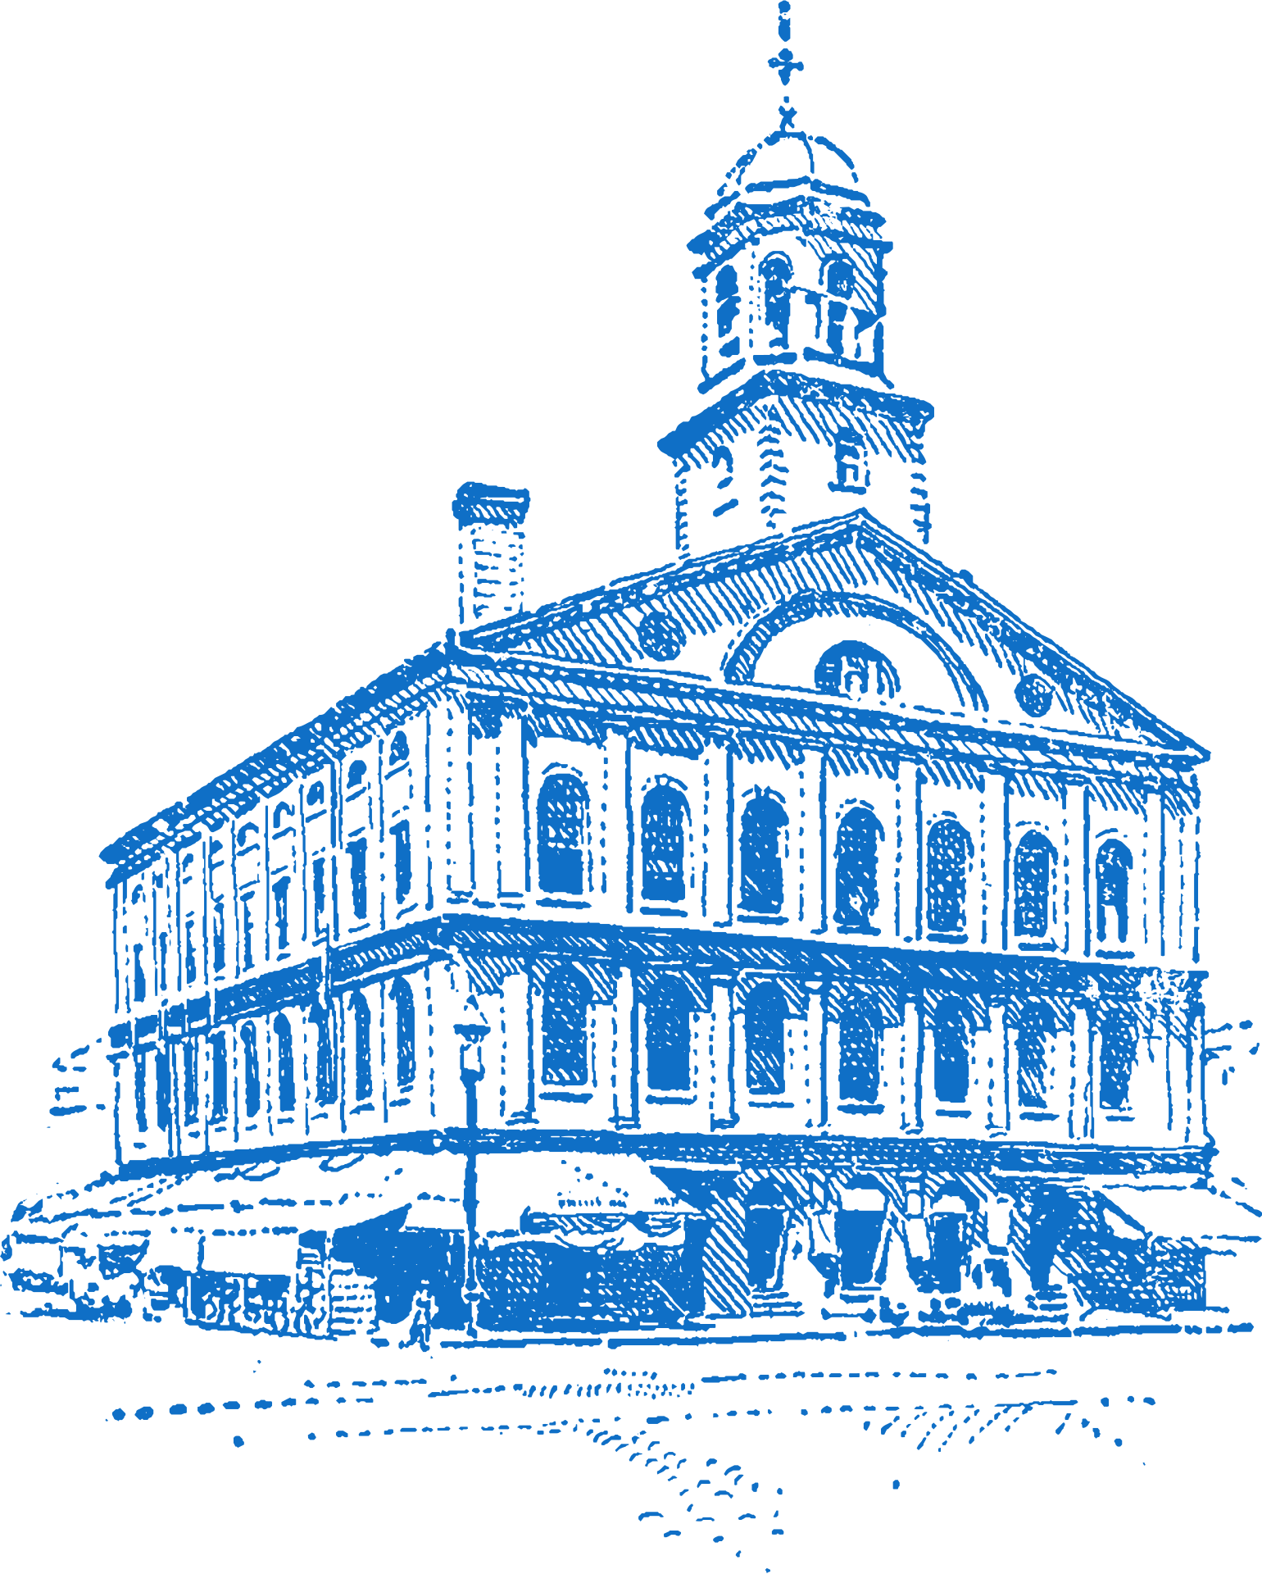

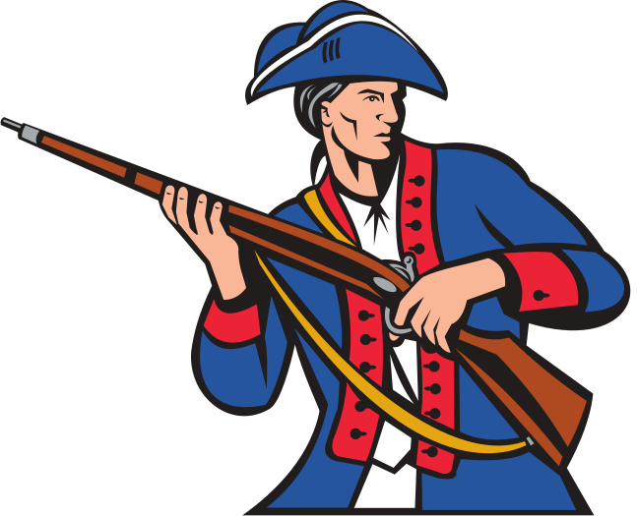
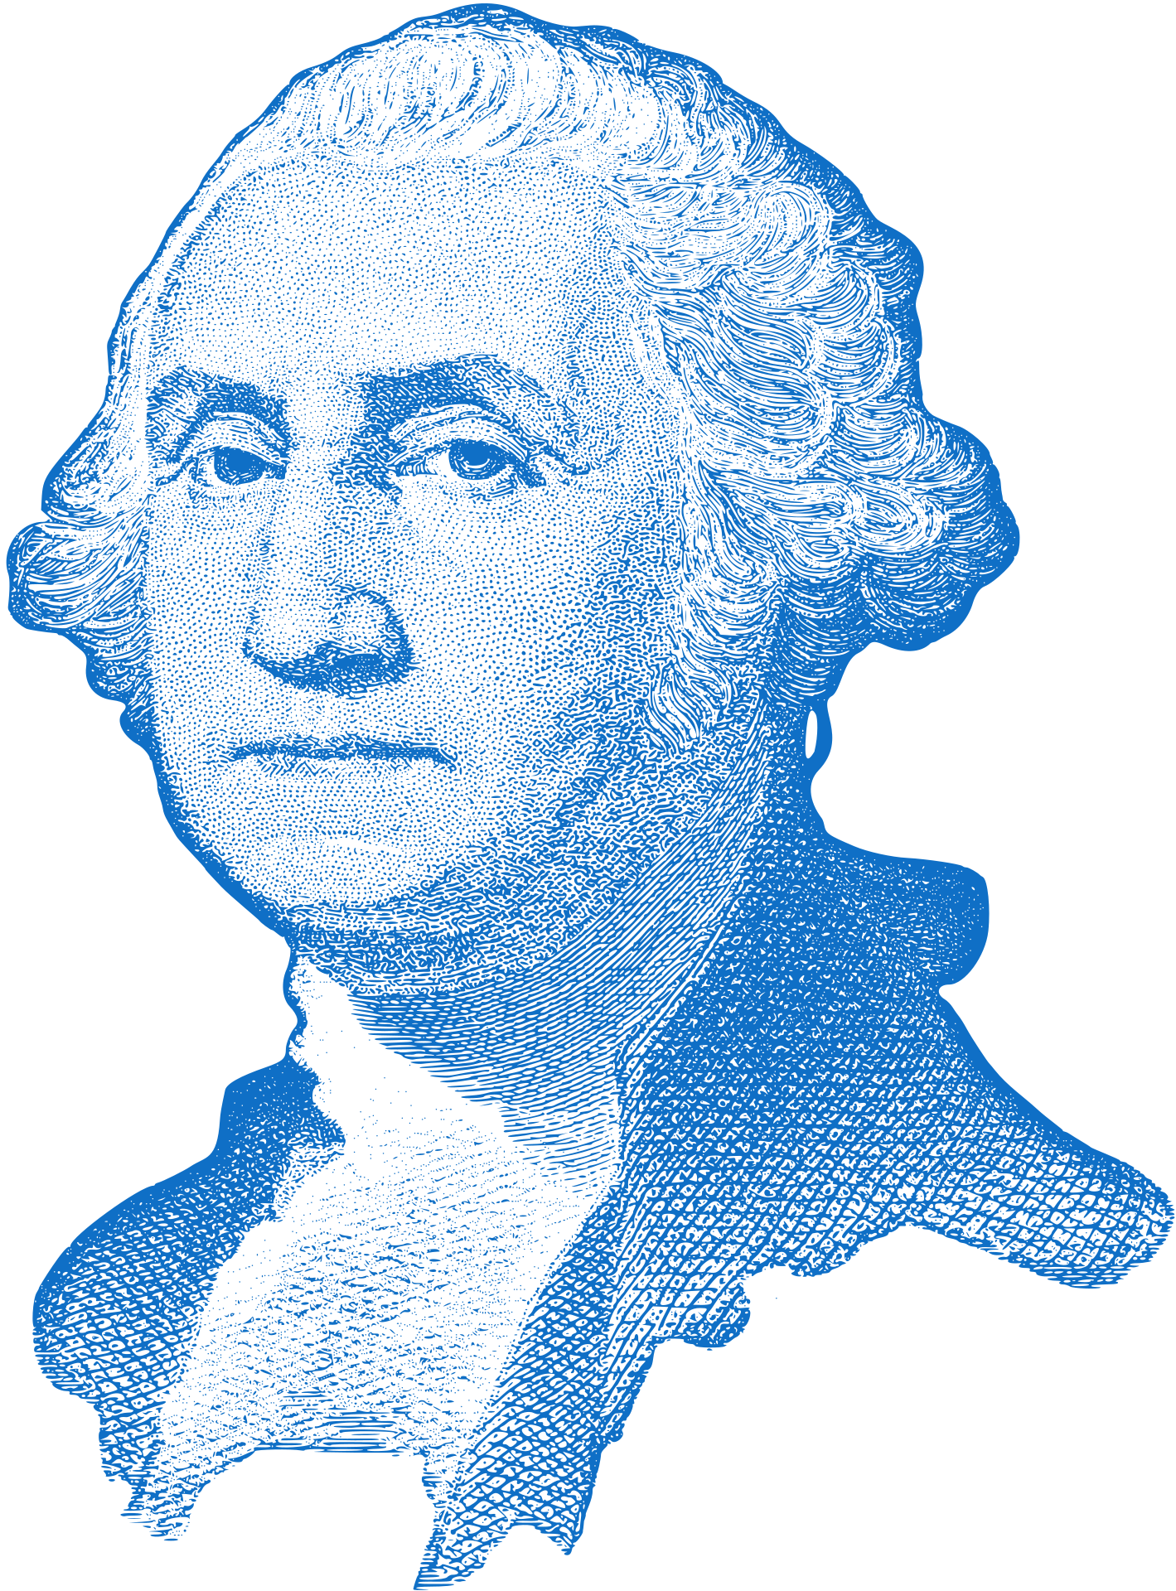
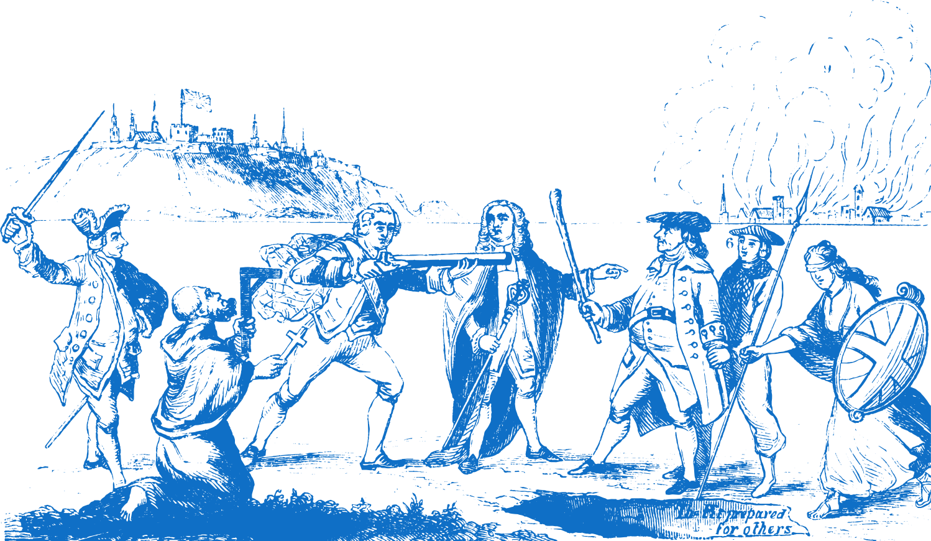
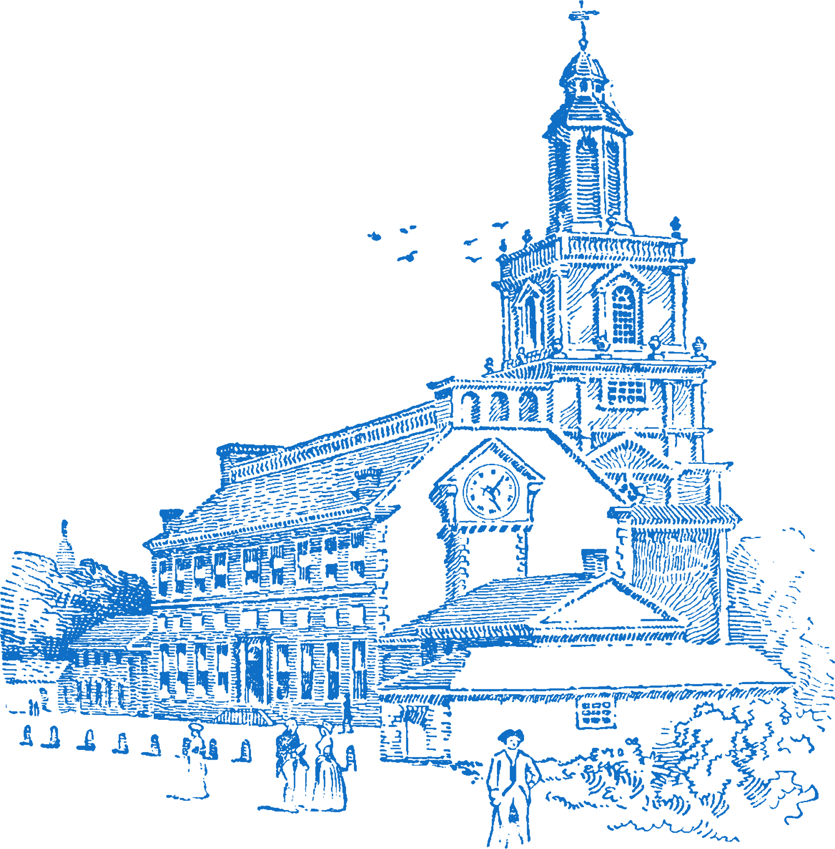

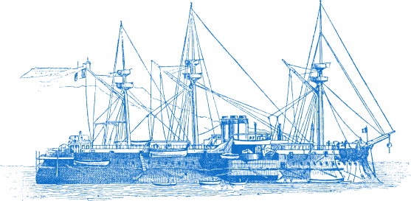

Chapter 12
THE AMERICAN REVOLUTION
3.3 EXAMINE the causes, course and consequences of one revolution in pre- twentieth century Europe and/or the wider world
The Boston Massacre and the Boston Tea Party mark the beginning of the Revolution
The Declaration of Independence is signed, separating the 13 Colonies from the British Empire
The Battle of Yorktown marks the turning point of the War of Independence
Strand Three: The History of Europe and the Wider World
Chapter Twelve: The American Revolution
1756-63
1774
1775
1776
1777
1778
1783
The Seven Years' War
The 'first world war' to take place. More commonly known as the French and Indian War.
Battles of Lexington and Concord begins the first military engagements of the war
George Washington and his army spend Winter at Valley Forge, retraining
Treaty of Paris marks the end of the War of Independence
@MsDoorley

Slide 3
Learning Outcomes
3.3 EXAMINE the causes, course and consequences of one revolution in pre- twentieth century Europe and/or the wider world.
1.2 CONSIDER contentious or controversial issues in history from more than one perspective and DISCUSS the historical roots of a contentious or controversial issue or theme in the contemporary world.
1.11 MAKE connections and comparisons between people, issues and events in different places and historical eras.
Strand Three: The History of Europe and the Wider World
Chapter Twelve: The American Revolution
@MsDoorley

Slide 4
Introduction
At the end of the eighteenth century, revolutions occurred on both sides of the Atlantic that had profound effects on the course of history. A revolution is a rapid and significant change in society, politics, technology or the economy. In America, France and Ireland, people rose up to overthrow the established order. They wanted to create new ways of running society where people would have a greater say over the laws that ruled their lives. The first of these revolutions took place in North America, where colonists fought against British rule.
Strand Three: The History of Europe and the Wider World
Chapter Twelve: The American Revolution
@MsDoorley

Slide 5
1756 to 1783
Chapter 12
12.1: THE CAUSES OF THE AMERICAN REVOLUTION
12.1: the causes of the american revolution
Strand Three: The History of Europe and the Wider World
@MsDoorley

Slide 6
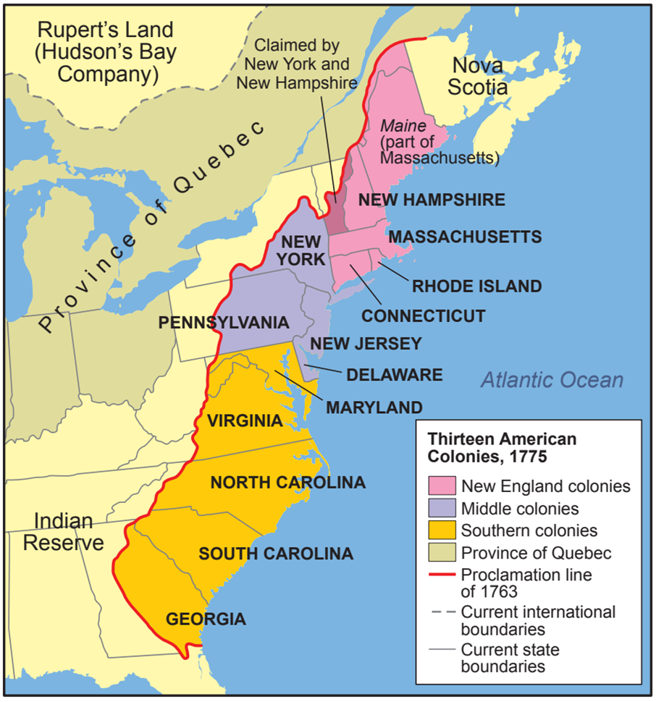
The 13 Colonies
From the 1600s, Britain had established 13 colonies along the eastern coast of North America. The colonists were from Britain and other European countries. They ran their own affairs through local assemblies while the British Crown was represented by a governor in each colony.
Between 1650 and 1750, the colonies’ population had grown to two million. Trading in tobacco, grain, cotton and fish made them very prosperous. Many of the colonists had left their home countries to escape religious or political persecution (like Catholics from Ireland and Britain). Others saw the colonies as a chance to become wealthy.
By the 1760s, various factors had come together to make the colonies unhappy with British rule.
Strand Three: The History of Europe and the Wider World
Chapter Twelve: The American Revolution
Diagram taken from Artefact, 2nd Edition by Eimear Jenkinson and Gregg O'Neill (educate.ie)
@MsDoorley

Slide 7
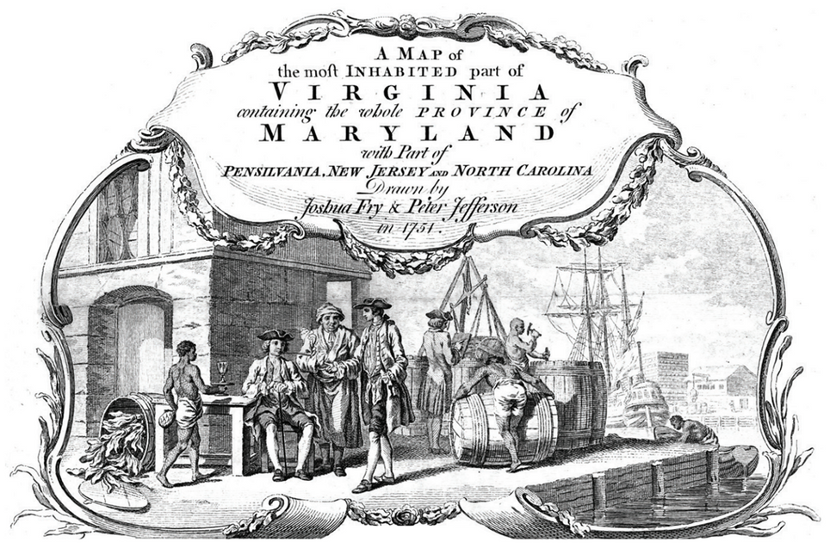
The Age of Enlightenment
The eighteenth century saw the Enlightenment emerge in Europe. This was a movement of thinker who valued reason and science above faith or authority as a basis for society. They challenged the idea that kings had a divine right to rule as they saw fit. Instead, the power of government should be limited while the rights of the people should be protected.
Strand Three: The History of Europe and the Wider World
Chapter Twelve: The American Revolution
Diagram taken from Artefact, 2nd Edition by Eimear Jenkinson and Gregg O'Neill (educate.ie)
@MsDoorley

Slide 8
Restriction on Trade
Relations between Britain and the colonies had become tense by the 1750s. Britain wanted a cheap supply of raw materials like cotton for its expanding industries – they saw America as one of their sources. However, the British did not want American competition for its industries; they wanted America as a market to sell the finished goods made by British industry using American materials.
The British parliament passed the Navigation Acts, which forced the colonises to sell some of their products (cotton, sugar, tobacco) to Britain alone. This meant that the British could decide the price, as the Americans had nobody else to sell to. These rules caused a lot of smuggling, leading to many clashes with the British navy.
Strand Three: The History of Europe and the Wider World
Chapter Twelve: The American Revolution
@MsDoorley

Slide 9
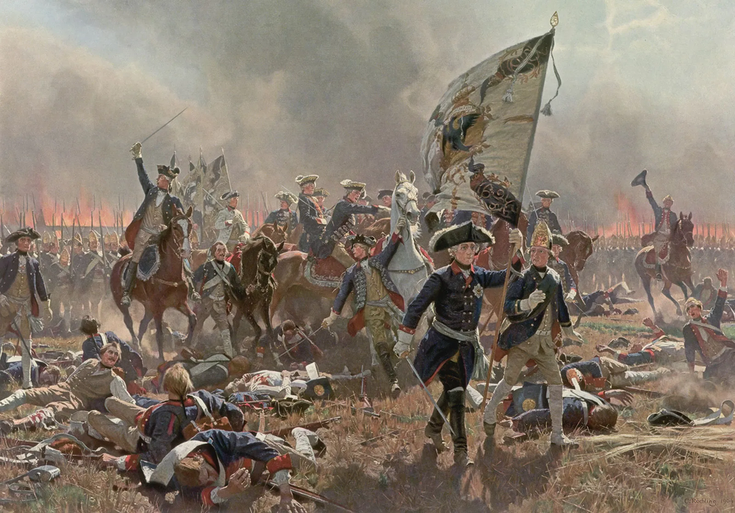
The Seven Years' War
France had also settled colonies in North America. During the Seven Years War (1756-1763), the British had defeated them, seizing a lot of their territory. Huge numbers of British soldiers fought in America and the British government wanted the colonies to contribute to the cost of the army that was there for their protection. The war also meant that many Americans had gained military experience through fighting with the British army such as George Washington.
Strand Three: The History of Europe and the Wider World
Chapter Twelve: The American Revolution
@MsDoorley

Slide 10

Britain was Broke
British was in financial trouble because of the war.
Westminster decided to make the colonists pay for the costs of their government and defence.
Strand Three: The History of Europe and the Wider World
Chapter Twelve: The American Revolution
@MsDoorley

Slide 11
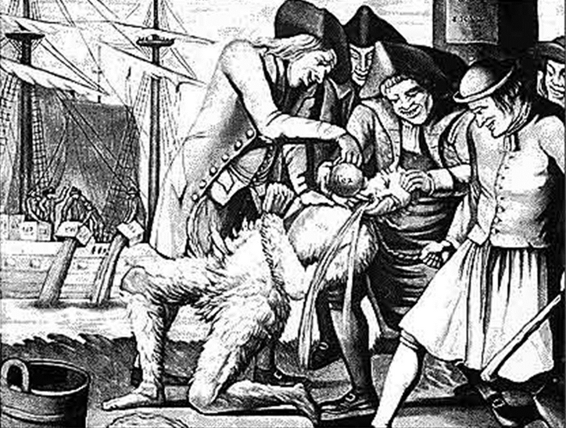

No Taxation without Representation
The British introduced the Stamp Act (1765) that required all legal documents, wills, newspapers and playing cards to have a paid government stamp and the Quartering Act (1765) that covered the cost of the soldiers in the colonies. This infuriated the colonists who did not want to pay more taxes, especially to a parliament in London where they had no representatives. ‘No Taxation Without Representation’ became the new slogan for opposition groups. Stamp men were beaten up and ‘tarred and feathered’. This resulted in the withdrawal of the Stamp Act in 1766.
Strand Three: The History of Europe and the Wider World
Chapter Twelve: The American Revolution
The Sons of Liberty were a secret organization formed in the American colonies in protest against the Stamp Act. They were organized by merchants, businessmen, lawyers, journalists, and others who would be most affected by the Stamp Act. They argued that Americans should govern themselves.
The flag of nine red and white stripes that represented the "Sons of Liberty" and became known as the "Rebellious Stripes."
@MsDoorley

Slide 12


Checkpoint pg. 135 (Artefact, 2nd Edition)
  What was the Enlightenment?
  How and why did the British try to limit American trade?
  What impact did the Seven Years’ War have on the colonies of America?
  What was the Stamp Act and how did Americans react to it?
  Which of the causes of the American Revolution do you think was the most important? Why?
Strand Three: The History of Europe and the Wider World
Chapter Twelve: The American Revolution
@MsDoorley

Slide 13
Checkpoint pg. 135 (Artefact, 2nd Edition)
1.The Enlightenment: a movement of thinkers in the eighteenth century who valued reason and science above faith or authority as a basis for society.
2.The British passed the Navigation Acts, which forced the colonies to sell some of their products to Britain alone. They did this because they wanted to use cheap American raw materials in their industries.
3.Britain wanted the colonies to contribute to the cost of their own defence. Also, many Americans gained military experience from fighting with the British army.
4.The Stamp Act required all sorts of documents to have a government stamp on them, which had to be paid for. The Americans were strongly opposed to it and attacked tax collectors, held protests and forced the British to withdraw the Act.
5.The Seven Years War
Age of Enlightenment
Restriction on Trade - No Taxation without Representation
Strand Three: The History of Europe and the Wider World
Chapter Twelve: The American Revolution
@MsDoorley

Slide 14
1756 to 1783
Chapter 12
12.2: THE ROAD TO WAR
12.2: the road to war
Strand Three: The History of Europe and the Wider World
@MsDoorley

Slide 15
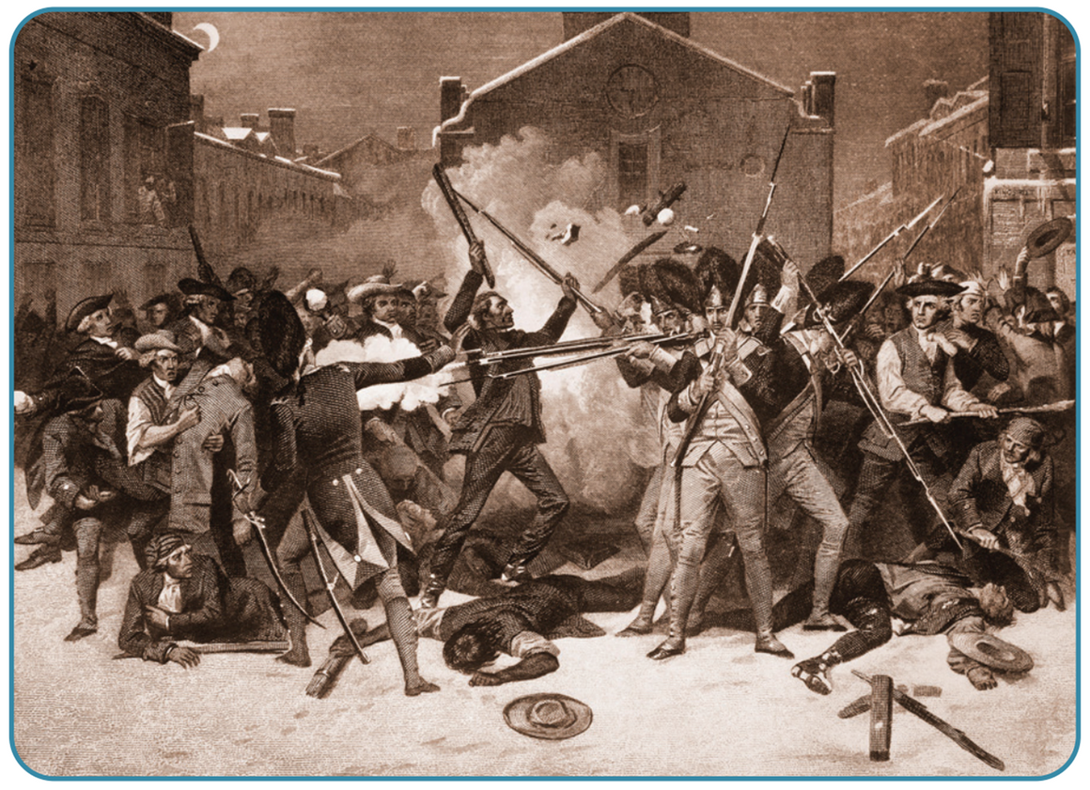
The Boston Massacre
After they had repealed the Stamp Act, the British imposed the Townshend Acts in 1767, placing taxes on goods that America imported (tea, glass, paint and lead). Tensions continued to rise, and in 1770 it came to a head. A mob who were protesting the Townshend Acts confronted a group of British soldiers. The soldiers opened fire and five people were killed. The event was known as the Boston Massacre – exaggerated accounts spread, claiming that the British soldiers acted first.
Strand Three: The History of Europe and the Wider World
Chapter Twelve: The American Revolution
Diagram taken from Artefact, 2nd Edition by Eimear Jenkinson and Gregg O'Neill (educate.ie)
@MsDoorley

Slide 16
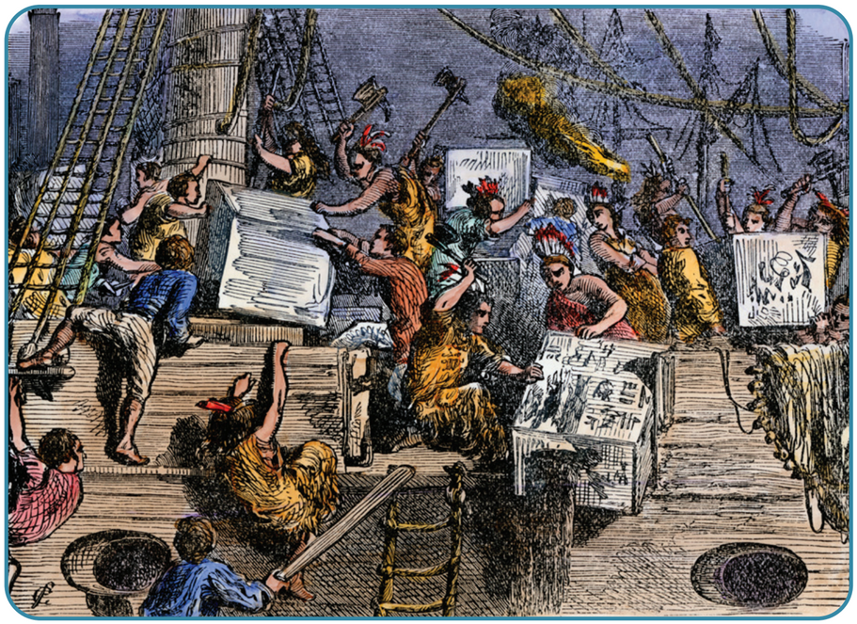
The Boston Tea Party
After the Boston Massacre, the British were forced to withdraw all the Townshend Acts and other taxes – except a small tax on tea imports as a sign they had the right to impose taxes on the colonies. In 1773, they passed the Tea Act that exempted the East India Company from paying the tea tax. In December 1773, a group from the Sons of Liberty dressed as Native Americans and duped 342 crates of East India Company tea into the Boston Harbour. This event would become known as the Boston Tea Party.
The British government, pressured by the East India Company, imposed what Americans called the ‘Intolerable Acts’ on Boston and the colony of Massachusetts. The port of Boston was closed until compensation for the tea had been paid, the city of Boston was put under military rule, and the colony’s assembly was suspended.
Strand Three: The History of Europe and the Wider World
Chapter Twelve: The American Revolution
Diagram taken from Artefact, 2nd Edition by Eimear Jenkinson and Gregg O'Neill (educate.ie)
@MsDoorley

Slide 17
The First Continental Congress
The actions seen in Massachusetts worried the other colonies; if it could happen there, it could also happen to their own colonies. Representatives of the colonies met in the Continental Congress in September 1774. The Congress opposed all British taxes, urged a boycott of British goods and demanded the removal of British soldiers. Some demanded all-out war, but the majority weren’t ready for it. Secret groups throughout the colonies began to stockpile weapons and militias (part-time armies) began to train/arm themselves.
Strand Three: The History of Europe and the Wider World
Chapter Twelve: The American Revolution
@MsDoorley

Slide 18
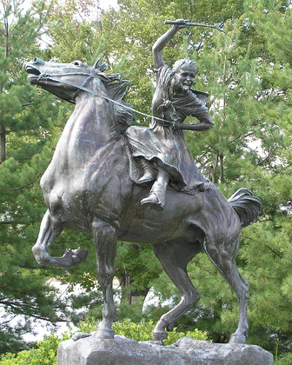
The Battles of Lexington and Concord
British General Gage tried to stop these developments before they became a full-scale rebellion. In April 1775, he sent 800 troops to seize weapons at Concord, near Boston. American rebel, Paul Revere heard about this and organised militiamen to ride through the countryside to warm the rebels that the British were coming. These militiamen were known as the ‘minute men’. At Lexington, on the way to Concord, a small force of American militiamen engaged the British troops. Ten Americans were killed, eight were captured. When the British finally reached Concord, the weapons were already gone. On their return to Boston, there was a second, larger battle where 273 British soldiers were killed.
Strand Three: The History of Europe and the Wider World
Chapter Twelve: The American Revolution
Did you know?
The same night as Revere's ride, a 16-year-old girl named Sybil Ludington rode twice the distance Revere had through the rain to alert the Continental troops. She returned home at dawn, having averted disaster, and George Washington thanked her personally for her courage.
Diagram taken from Artefact, 2nd Edition by Eimear Jenkinson and Gregg O'Neill (educate.ie)
@MsDoorley

Slide 19
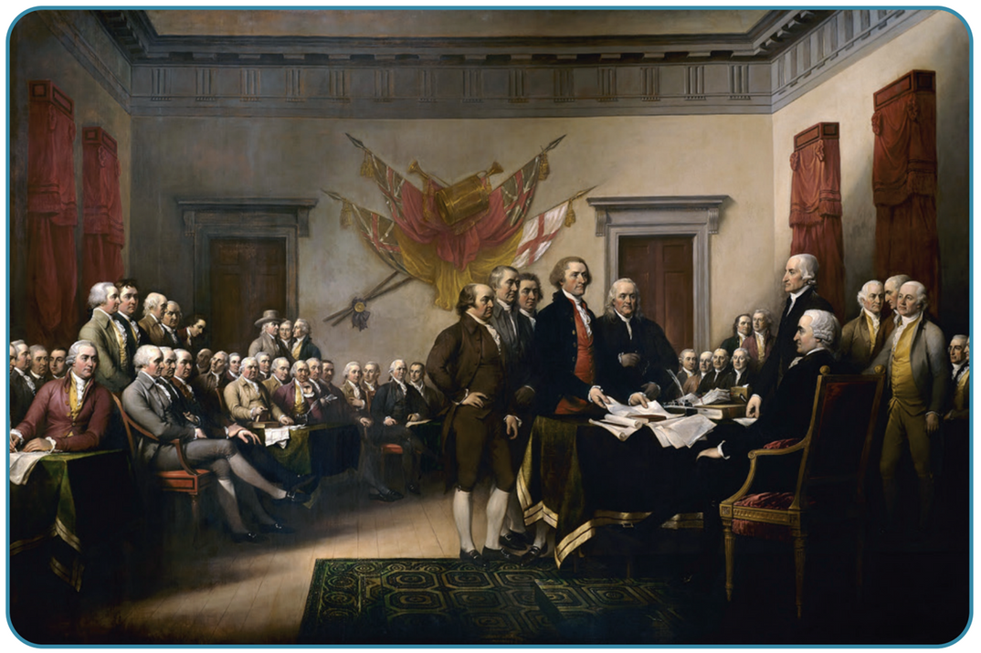
The Second Continental Congress
The violence in Massachusetts convinced many that war was now inevitable. Thomas Paine published his pamphlet, the Common Sense, that was read widely throughout the colonies. It stated that the American people should be independent from British oppressive control. The Second Continental Congress met in 1776, George Washington was elected as Commander-in-Chief of the Continental Army. On the 4th July 1776, the Congress issued the Declaration of Independence to declare independence from Britain.
Strand Three: The History of Europe and the Wider World
Chapter Twelve: The American Revolution
Diagram taken from Artefact, 2nd Edition by Eimear Jenkinson and Gregg O'Neill (educate.ie)
@MsDoorley

Slide 20
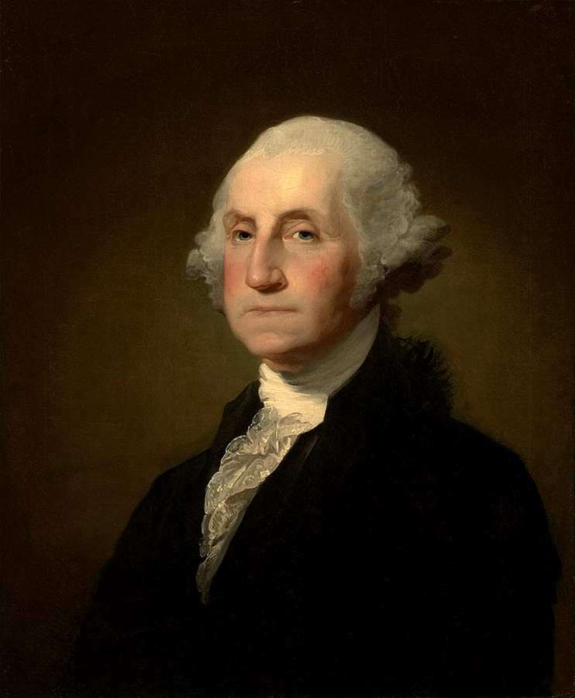
George Washington, 1732-1799
George Washington was born in the colony of Virginia to a family of wealthy slave-owning, tobacco-farming landowners. He fought in the British army in the Seven Years' War and afterwards was elected to Virginia's assembly. He was elected to represent Virginia at the Continental Congresses, where he supported independence. He was appointed commander-in-chief of the Continental Army in 1775 and led the army in many key battles of the war. Washington was elected the first President of the USA in 1789 and was re-elected in 1792. He worked to set up the new government, surrounding himself with the best men of his era to work with him: Thomas Jefferson, Alexander Hamilton and John Adams. He retired in 1797 and died from pneumonia in 1799. The capital of the US was named 'Washington' in his honour.
Strand Three: The History of Europe and the Wider World
Chapter Eight: The Renaissance
Diagram taken from Artefact, 2nd Edition by Eimear Jenkinson and Gregg O'Neill (educate.ie)
@MsDoorley

Slide 21
Checkpoint pg. 29 (Artefact, 2nd Edition)
  What happened at the Boston Massacre and how did Britain respond?
  What caused the Boston Tea Party?
  What were the ‘Intolerable Acts’ and how did the other colonies respond to them?
  What decisions did the First Continental Congress make?
  What happened at Lexington and Concord?
  Why is the 4th July celebrated every year in the United States of America?
Strand Three: The History of Europe and the Wider World
Chapter Twelve: The American Revolution
@MsDoorley

Slide 22
Checkpoint pg. 29 (Artefact, 2nd Edition)
1. British soldiers opened fire on a crowd in Boston, killing five. The British withdrew the last of the restrictions and taxes on the colonies, except one on tea.
2.The British imposed a tax on tea to show they could still tax the colonies. When they decided to exempt the East India Company from this tax, the Americans were outraged and protested by throwing the tea shipment into Boston harbour.
3.The British blockaded Boston harbour, suspended the city’s assembly and imposed military rule on the city. The other colonies sent representatives to the First Continental Congress to consider their response.
4.They stated their opposition to all taxes, ordered a boycott of British goods, demanded the removal of British soldiers and ordered the formation of local militias.
5.The British army tried to seize the weapons of the colonists at Concord and they were ambushed on the way there at Lexington by American militiamen.
6.It was the day that the Continental Congress issued the Declaration of Independence.
Strand Three: The History of Europe and the Wider World
Chapter Twelve: The American Revolution
@MsDoorley

Slide 23
1756 to 1783
Chapter 12
THE AMERICAN WAR OF INDEPENDENCE
the american war of independence
Strand Three: The History of Europe and the Wider World
@MsDoorley

Slide 24

The Continental Army
Washington was appointed commander-in-chief of the Continental Army in 1775 because of his military experience and the guaranteed support of the largest and richest colony. Washington faced a daunting situation as his army faced a colossal fight.
The Continental Army
The British Army
20,000 men
Part-time soldiers, many only serving for short periods
Poorly trained and equipped: a variety of guns and other weapons, even makeshift ones from farm tools.
Problems of indiscipline and disease
Congress was slow to pay the army
The soldiers had local knowledge and could use this against the British
80,000 men
Professional, full-time soldiers
Well trained and equipped with the best weapons of the time
Large navy supplies
Fighting in an unfamiliar country and thousands of miles from home
Treated all Americans as enemies and punished civilians, increasing support for the rebels
Strand Three: The History of Europe and the Wider World
Chapter Twelve: The American Revolution
@MsDoorley

Slide 25
Key battles in the War of Independence
Fighting broke out in 1775, leading to a number of major battles:
  Washington lost his first battle, at Bunker Hill, but inflicted heavy casualties on the British.
  The Continental Army won the Battle of Boston, capturing cannons and rifles that were needed for the war.
  Washington was defeated at New York in 1776 but gained two small victories at Princeton and Trenton.
  In 1777, the British General Howe’s army of 18,000 men captured Philadelphia, America’s largest city and the home of Continental Congress. This was a huge blow; began to doubt that America could win, questioning Washington’s leadership.
Strand Three: The History of Europe and the Wider World
Chapter Twelve: The American Revolution
@MsDoorley

Slide 26
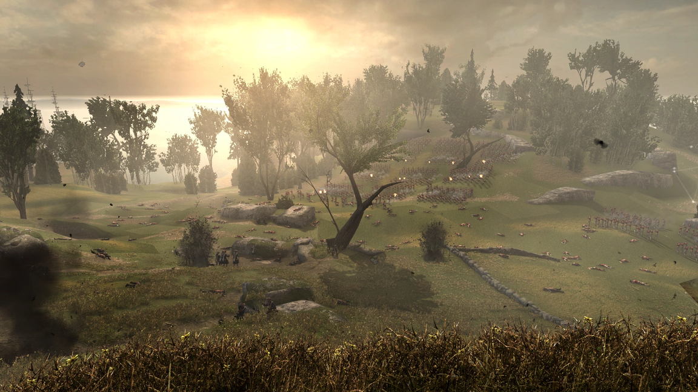
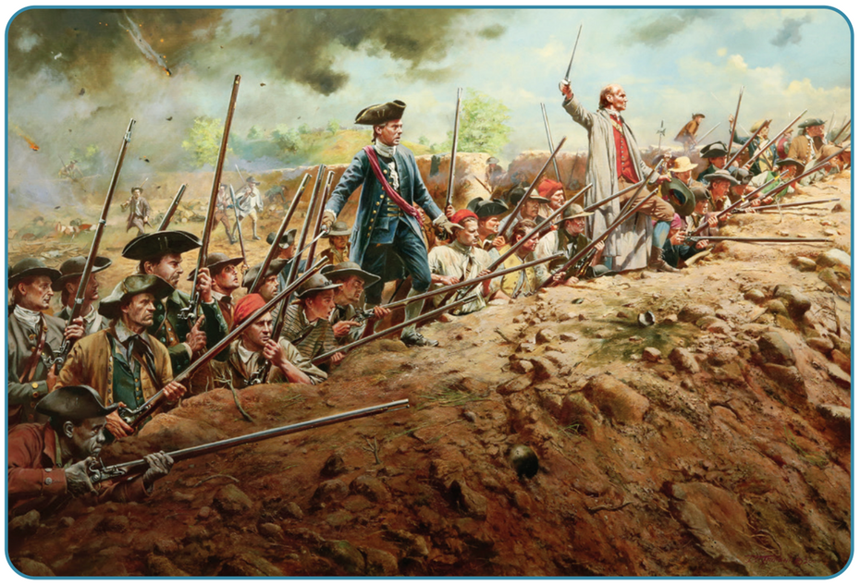
Turning Point: Saratoga and the entry of the French
The month after the loss of Philadelphia, American General Gates defeated a British army of 8,000 men at Saratoga. This victory reassured the American people while interesting some of Britain’s European rivals. France, Spain and the Netherlands joined the war against the British in 1778. French help was particularly key to the colonies’ eventual victory – they sent 6,000 troops and weapons while they used their fleet to disrupt British supplies. This meant that more British troops remained home in case of a French attack there.
Strand Three: The History of Europe and the Wider World
Chapter Twelve: The American Revolution
Diagram taken from Artefact, 2nd Edition by Eimear Jenkinson and Gregg O'Neill (educate.ie)
@MsDoorley

Slide 27
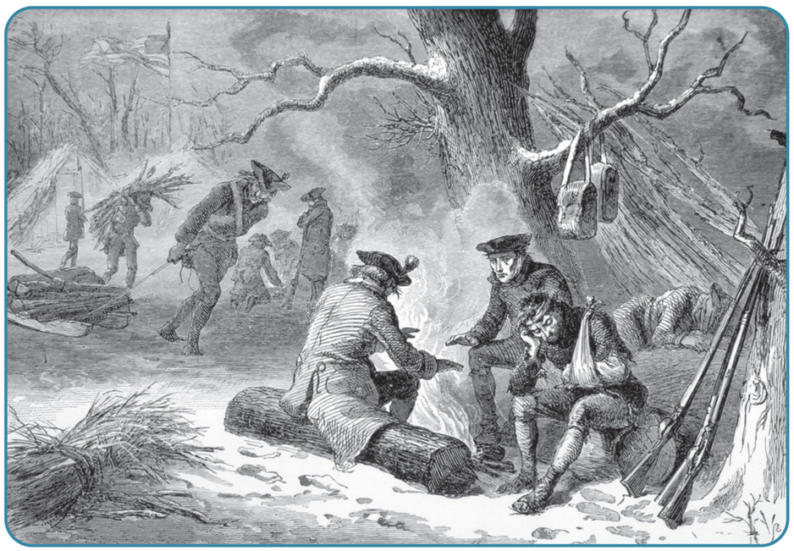
Turning Point: Valley Forge
Washington regrouped at a remote base called Valley Forge with 11,000 men during the winter of 1777-1778, one of the harshest winters of the century. The men endured great hardship and hunger in the freezing cold, disease killing 3,000 by the end of February while hundreds more deserted (abandoned) the army. The army that emerged from Valley Forge at winter’s end had been transformed; Washington had won the undying loyalty of his men by refusing to abandon them. They had been trained by the professional soldier Baron Von Steuben had drilled the soldiers until they were as well trained and disciplined as any European army.
Strand Three: The History of Europe and the Wider World
Chapter Twelve: The American Revolution
Diagram taken from Artefact, 2nd Edition by Eimear Jenkinson and Gregg O'Neill (educate.ie)
@MsDoorley

Slide 28
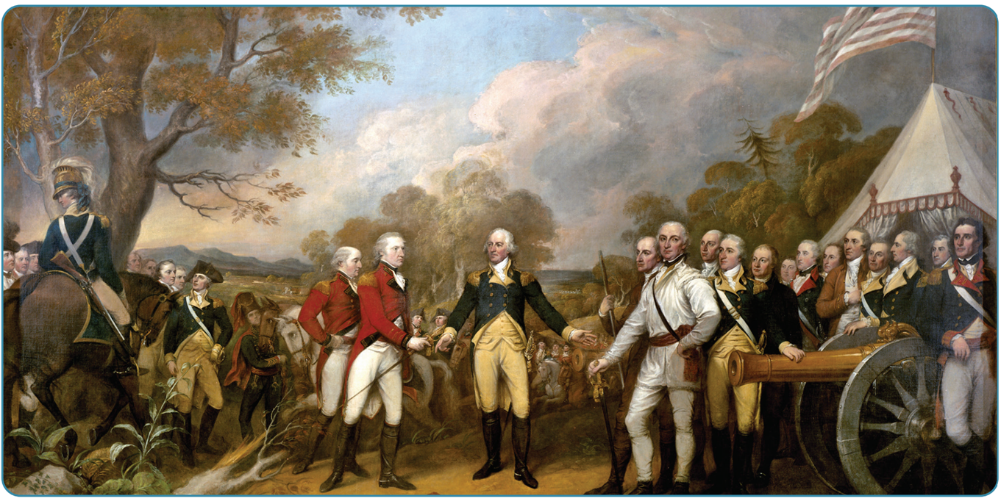
Victory at Yorktown
The balance of the war had turned in favour of the Americans. They won more battles and Washington kept the British largely confined to New York. The battle of Yorktown in October 1781 was decisive; 7,000 British soldiers under Lord Cornwallis were surrounded by 9,000 American and 5,000 French troops along with the French fleet. Cut off from reinforcements and supplies, outnumbered two to one, Cornwallis surrendered to Washington. This marked the end of the war, the Treaty of Paris was signed between the former colonies and the British in 1783.
Strand Three: The History of Europe and the Wider World
Chapter Twelve: The American Revolution
Diagram taken from Artefact, 2nd Edition by Eimear Jenkinson and Gregg O'Neill (educate.ie)
@MsDoorley

Slide 29
Checkpoint pg. 141 (Artefact, 2nd Edition)
  What advantages and disadvantages did the Continental Army have at the start of the war?
  What advantages and disadvantages did the British Army have at the start of the war?
  Why was the victory at Saratoga so important to the Americans?
  What happened at Valley Forge?
  Give three reasons why the Americans won the war.
Strand Three: The History of Europe and the Wider World
Chapter Twelve: The American Revolution
@MsDoorley

Slide 30
1756 to 1783
Chapter 12
12.4: THE RESULTS OF THE AMERICAN REVOLUTION
12.4: the results of the american revolution
Strand Three: The History of Europe and the Wider World
@MsDoorley

Slide 31
Foundation and Growth of the United States of America
The most significant result of the American Revolution was independence of the 13 colonies. After the Treaty of Paris in 1783, conflicts arose among the colonies. In order to prevent these problems from occurring again, the President of the Constitutional Convention was called in 1787. This was chaired by George Washington and contained representatives from all the new states. It wrote the constitution for their new country, the United States of America. A constitution is the set of fundamental rules for running a country that outlines the powers of government and the rights of citizens. The American constitution established a federal republic (a system of government where power is divided between a central government (head by a president) and various regions/states)
The US would grow to 50 states over the next 200 years, spreading from the Atlantic Ocean to the Pacific Ocean. It was the first time a State was established on the basis that power belonged to the People, not a Royal Family. This expansion saw Native American peoples and their culture all but wiped out. By 1900, millions of immigrants from all over the world had made America their home while the country had become one of the most powerful in the world.
Strand Three: The History of Europe and the Wider World
Chapter Twelve: The American Revolution
@MsDoorley

Slide 32
The Impact on France and Ireland
News of the Americans overthrowing the rule of a king they found unjust spread quickly through newspapers, letters and returning soldiers. It inspired the people of France, bankrupted by wars, to challenge King Louis XVI and led to the French Revolution in 1789. Under British rule since the 1100s, the Irish people looked to America’s example and dreamed of an independent Ireland. This would lead to the 1798 United Irishmen Rebellion.
Strand Three: The History of Europe and the Wider World
Chapter Twelve: The American Revolution
@MsDoorley

Slide 33
The influence of ideas
The Declaration of Independent states that ‘all men are created equal’ but this equality and freedom was limited to rich white Christian men following the creation of the US.
  Women were treated as second-class citizens with few rights separate from those of their husbands or fathers.
  Millions of black slaves were kept by owners (including ‘Founding Fathers’ Washington and Thomas Jefferson) across the southern US.
  Native Americans were killed in their hundred of thousands, driven from their lands and saw their culture almost wiped out.
While there were issues within this new state, their ideals inspired all these groups (and peoples abroad) to keep fighting for their equal rights over the next 200 years and demanding their share in America's promise of liberty. Slavery was abolished after the US Civil War in the 1860s, through inequality and racism continued. Women campaigned for the right to vote in the early twentieth century and again demanded greater equality after World War II. While the rights of these people are still not on full equal terms, the fight for equal rights in the US continues.
Strand Three: The History of Europe and the Wider World
Chapter Twelve: The American Revolution
@MsDoorley

Slide 34
Checkpoint pg. 142 (Artefact, 2nd Edition)
  How did the US grow after independence from Britain?
  What impact did the American Revolution have on (a) France and (b) Ireland?
  How do you think the ideals of the American Revolution influenced women, slaves and Native Americans in the future?
Strand Three: The History of Europe and the Wider World
Chapter Twelve: The American Revolution
@MsDoorley

Slide 35
Checkpoint pg. 142 (Artefact, 2nd Edition)
  US territory expanded to the west coast and grew to 50 states.
  (a) The French were influenced by the ideals of freedom and equality. In addition, the cost of the war in America (together with their king’s lifestyle) bankrupted France, causing the crisis that brought on the Revolution; (b) Ireland was inspired by the ideals of equality and of independence from Britain.
  The Revolution was based on the inalienable rights of people and the need for equality. All those groups were treated unequally and therefore the ideals of the Revolution encouraged them to fight for the freedom and equality promised in the Declaration of Independence.
Strand Three: The History of Europe and the Wider World
Chapter Twelve: The American Revolution
@MsDoorley

Slide 36
1517 to 1650
Chapter 10
12.6: SUMMARY
12.6: summary
Strand Three: The History of Europe and the Wider World
@MsDoorley

Slide 37
In this chapter, we have learned that...
The causes of the American Revolution can be divided into long term and short term causes:
Long-term Casues | Short-Term Causes
The Age of Enlightenment | The Boston Massacre
British Restrictions on American trade | The Boston Tea Party
The Seven Years’ War | The Continental Congresses
‘No Taxation without Representation’ | The Battles of Lexington and Concord
Strand Three: The History of Europe and the Wider World
Chapter Twelve: The American Revolution
The American colonies declared their independence from Britain in July 1776. The next five years was a difficult war against the British. Several early defeats were followed by the American victory over Britain at Saratoga. Washington retrained his army in Valley Forge in 1777-78 and they were joined by the French army.
The Americans defeated the British at Yorktown in 1781 under Washington’s command. This victory brought the end to all fighting and the colonies were given their independence through the Treaty of Paris (1783).
After the success of the American Revolution, the peoples of France and Ireland were inspired to follow the American example. The ideals of freedom and equality behind the revolution continued to inspire many to stand up for the rights of minorities within their own country.
@MsDoorley

Slide 38
Reflecting on... the American Revolution
The American Revolution was a key even in world history. It saw the birth of a nation that would eventually become the most powerful in the world. It saw the first expression of the rights to freedom and equality for all and established the idea that governments must answerable to those whom they govern.
Strand Three: The History of Europe and the Wider World
Chapter Twelve: The American Revolution
@MsDoorley

Slide 39
Examination Questions
2022 SEC Q4
Strand Three: The History of Europe and the Wider World
Chapter Twelve: The American Revolution
@MsDoorley

Slide 40
Project
Guidelines:
  Length: The depth of your project should reflect about 2-3 weeks of work.
  Sources: Use at least three different sources for your research. These can be books, scholarly articles, or reputable online resources.
  Citations: All information and images that are not your own should be properly cited.
  Mediums: You may choose to present your project in one of the following ways:
    Poster: Your poster should be informative and visually engaging.
    Minecraft or Lego Model: If choosing this option, please also include a brief report explaining your model.
    Painting/Drawing: Your artwork should be accompanied by a description.
    Recycled Materials: Create your model using recycled materials and provide an explanation of your creative process.
Assessment:
Your projects will be assessed based on:
  Research and Content
  Creativity and Presentation
  Understanding of Context
  Adherence to Guidelines
Strand Three: The History of Europe and the Wider World
Chapter Twelve: The American Revolution
@MsDoorley

Slide 41
Project
Historical Sites
Historical Figures
Paul Revere's House, Boston, Massachusetts
Independence Hall, Philadelphia, Pennsylvania
Yorktown Battlefield, Virginia
The Old North Bridge, Concord, Massachusetts
Saratoga National Historical Park, New York
John Adams
Andrew Jackson
Molly Pitcher
Benjamin Franklin
Samuel Adams
George Washington
Thomas Jefferson
Marquis de Lafayette
Abigail Adams
Alexander Hamilton
Benedict Arnold
George III
Strand Three: The History of Europe and the Wider World
Chapter Twelve: The American Revolution
@MsDoorley

